Slide 1
GCPP SYSTEM (General Cancer Probability Prediction)
#NEVER LATE TO BE AWARE!
GROUP 2
2 ISA 2

Slide 2



THE DEVELOPER
Rafie Ananda Suhermawan (2120010299)
Riki Awal Syahputra (2120010136)
Alfisyahrin Gusman (2120010016)
LEADER
DEVELOPER
DEVELOPER

Slide 3
TABLE OF CONTENTS
Definition
The Code and Result
01
03
Flowchart
Configuration
02
04
See what happens when it works
About the GCPP System
What you need to run the system
How it flows in the
program

Slide 4
—GERTRUDE B. ELION
“I had no specific bent toward science until my grandfather died of stomach cancer. I decided that nobody should suffer that much..”

Slide 5

01
DEFINITION
What is GCPP System, how it works and for what?

Slide 6

What is Cancer
A disease in which some of the body's cells grow uncontrollably and spread to other parts of the body. Cancer can start almost anywhere in the human body, which is made up of trillions of cells
Accounts for 7.4 million deaths worldwide.

Slide 7

What is GCPP System
The system to predict the probability of covering potential cancer risk in general (not specific) and not for the diagnosis, reference data is covered through cancer.net, halodoc.com, and ATSDR (Agency for Toxic Disease Registry)

Slide 8
PARAMETER
AGE
GENETIC
DISEASE
ENVIRONMENT
INFECTION
LIFESTYLE
VACCINATION
JOB

Slide 9
Example of GCPP Result
AGE: | 19 years
GENDER: | Male
DOMICILE: | South Jakarta
CANCER RISK SCORE: | 37.59%
Genetic
Lifestyle
Infection

Slide 10

02
FLOWCHART
How it flows in the
program

Slide 11
FUNCTION FLOW
Phase 1
Phase 2
Phase 3
Phase 4
Phase 5
Welcoming &
information
Registration
Screening
Result
Save to .CSV database

Slide 12
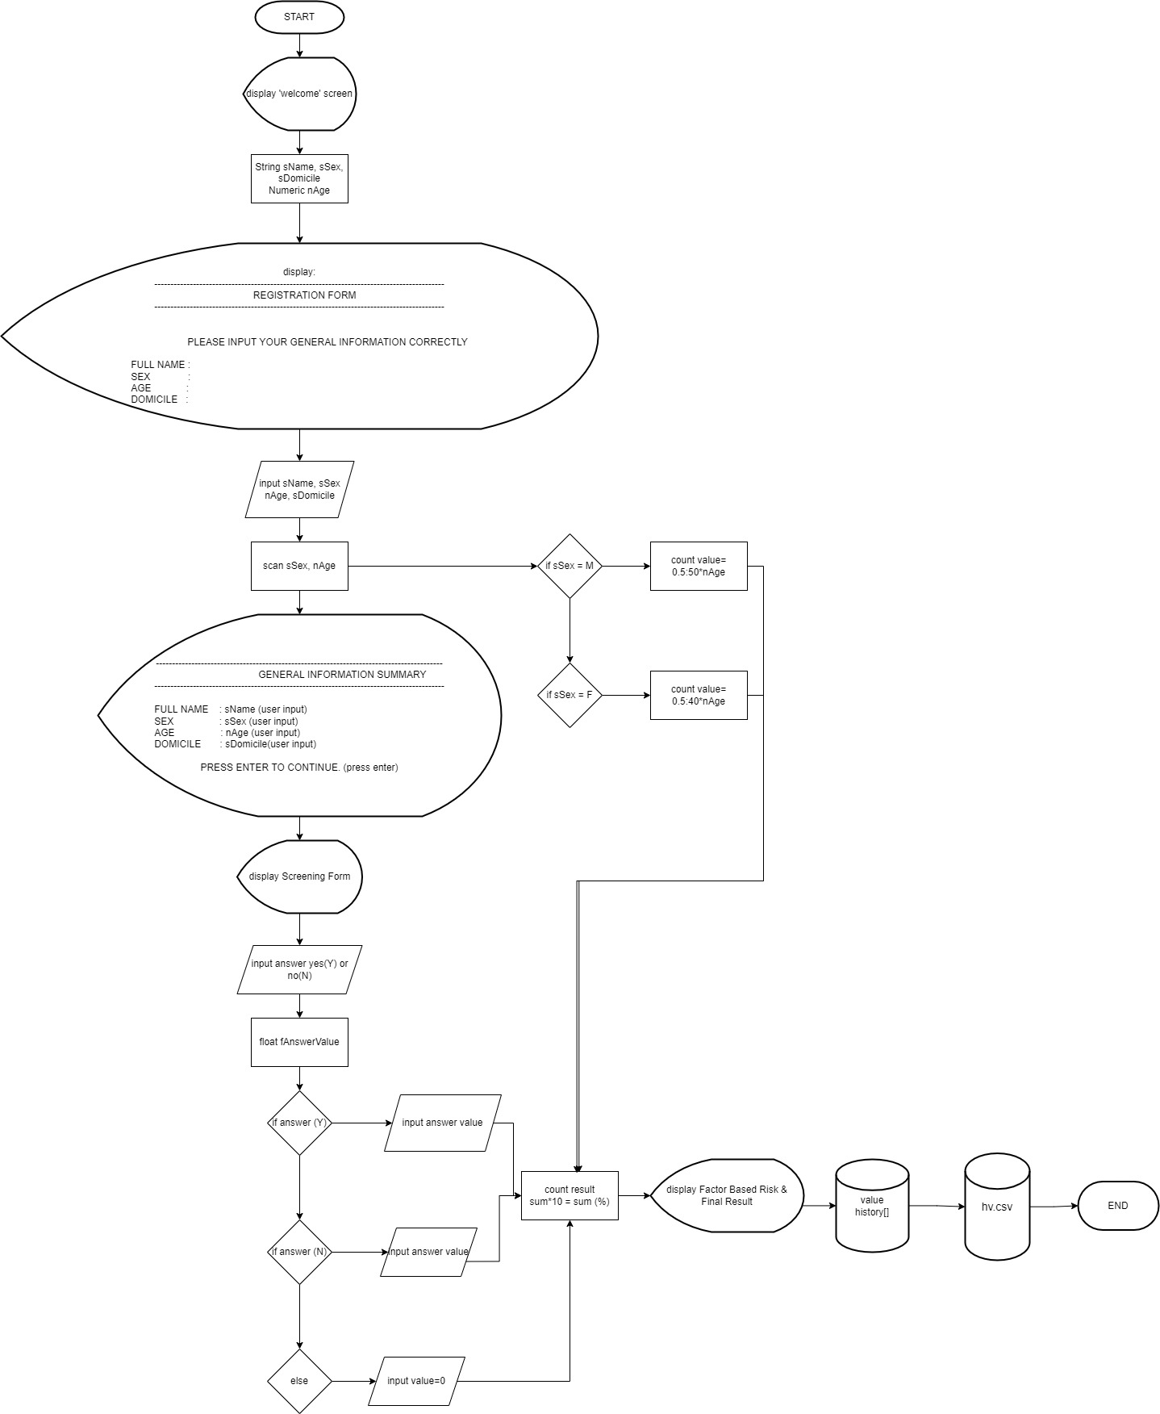
GCPP Flowchart in General

Slide 13

03
THE CODE AND RESULT
Let’s take a look!

Slide 14
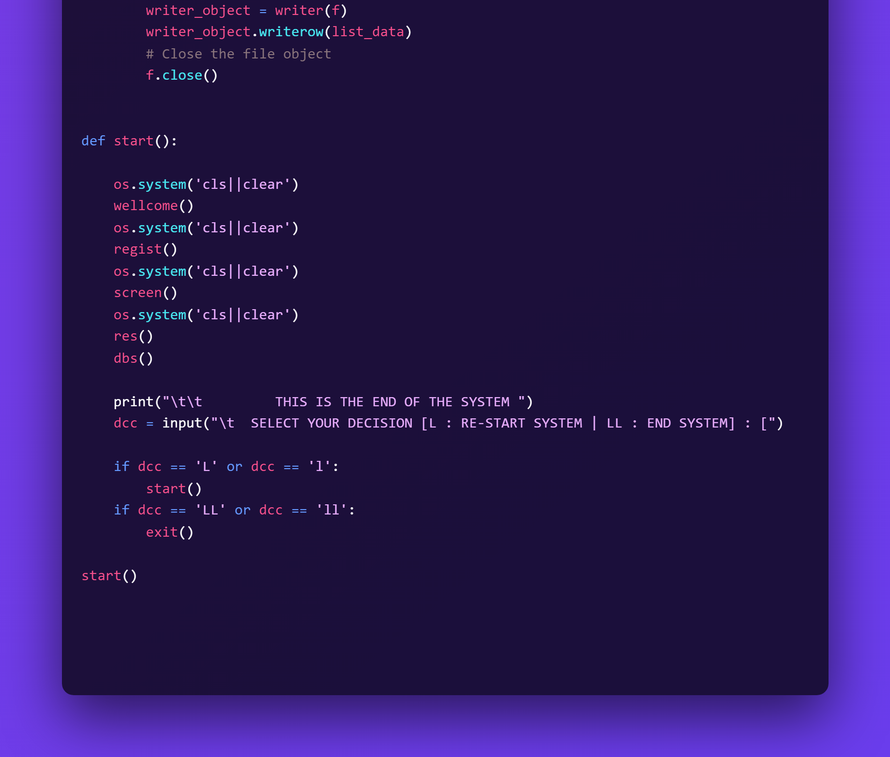
WHOLE PROCESS FUNCTION

Slide 15
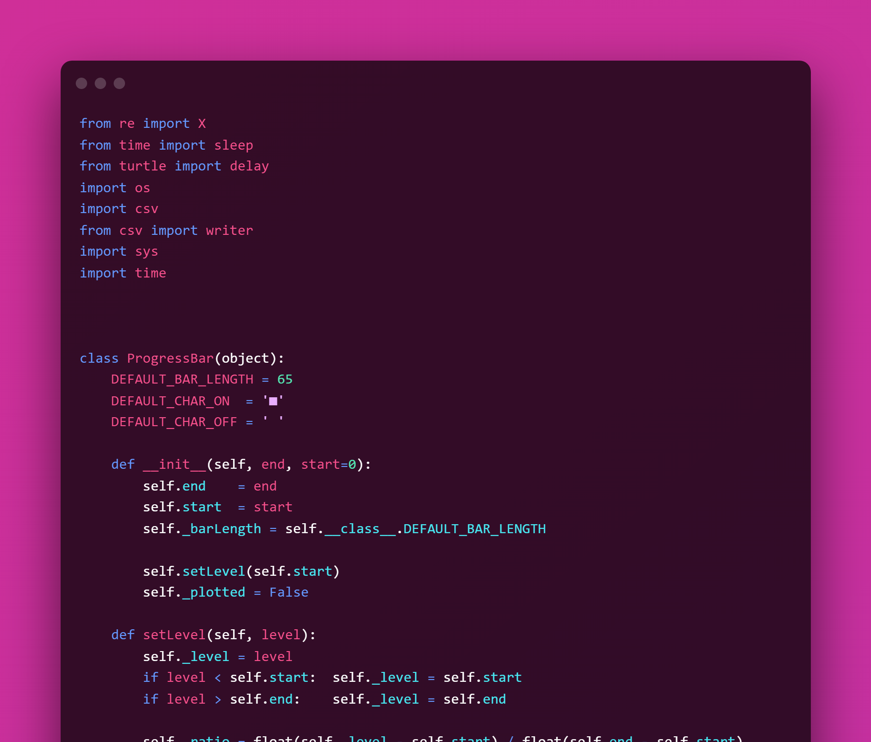
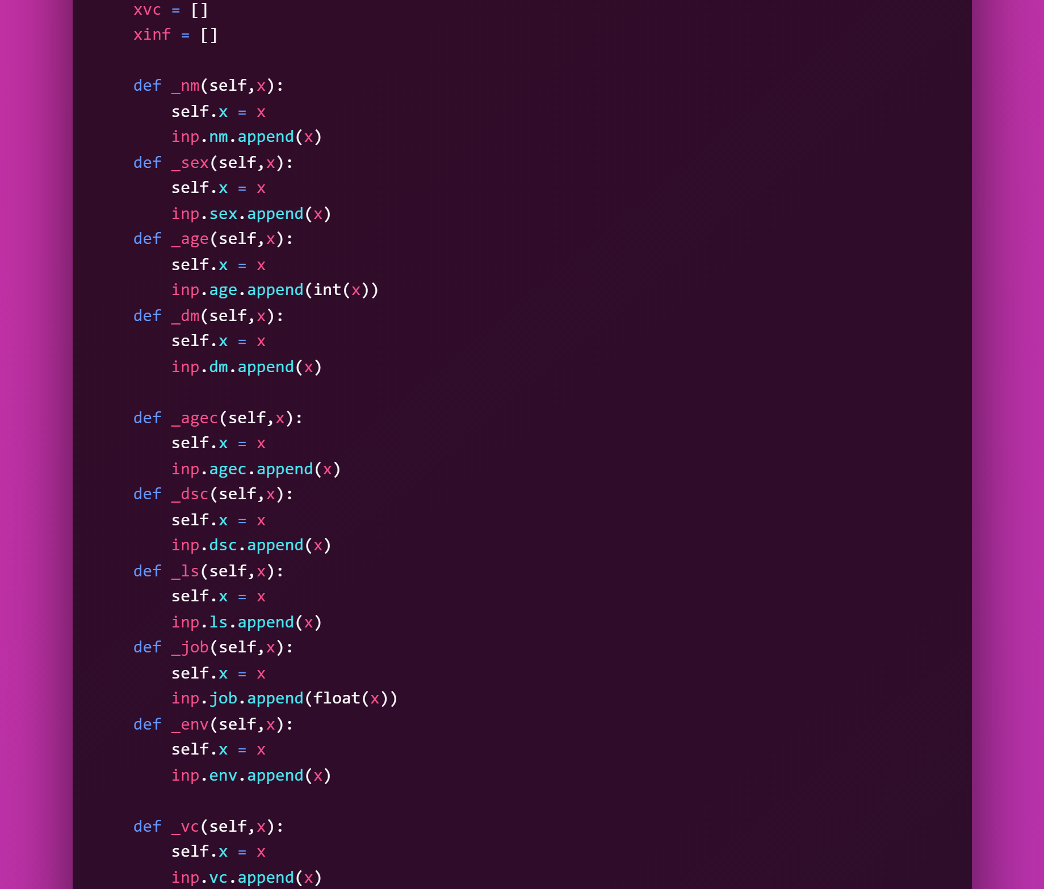
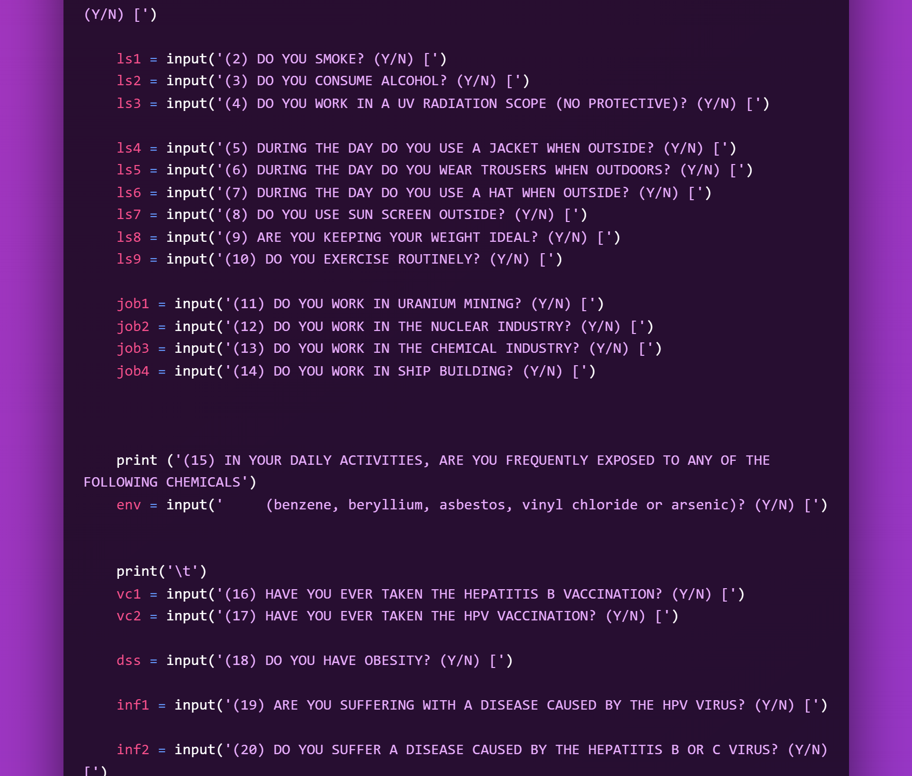
INPUT LIBRARY
CLASS FUNCTION TO STORE DATA
THE QUESTION AND VARIABLE INPUT

Slide 16
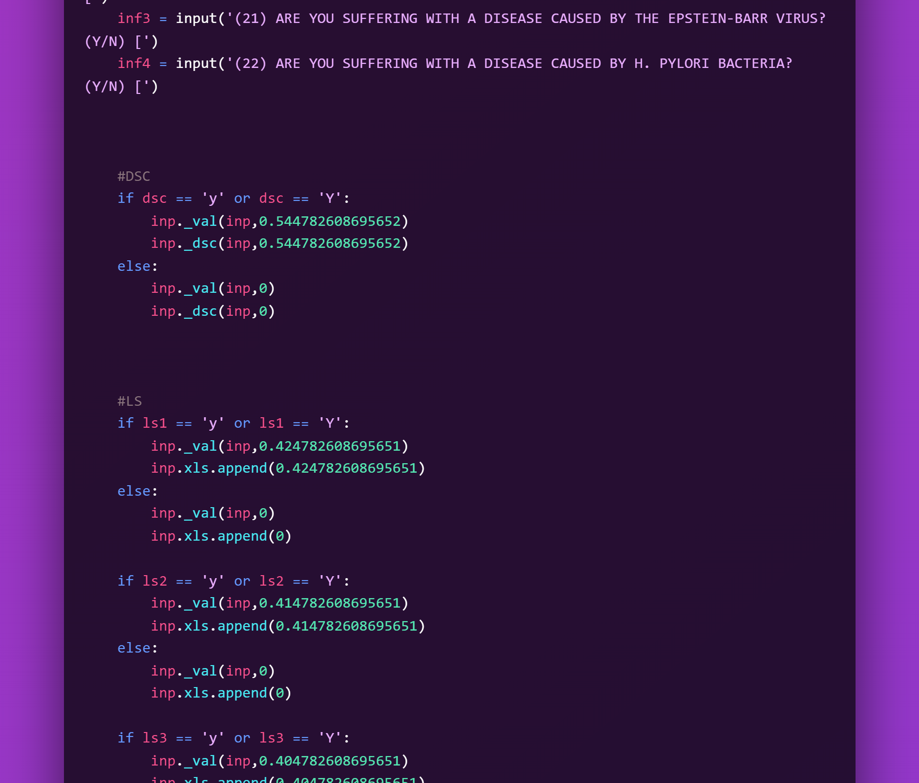
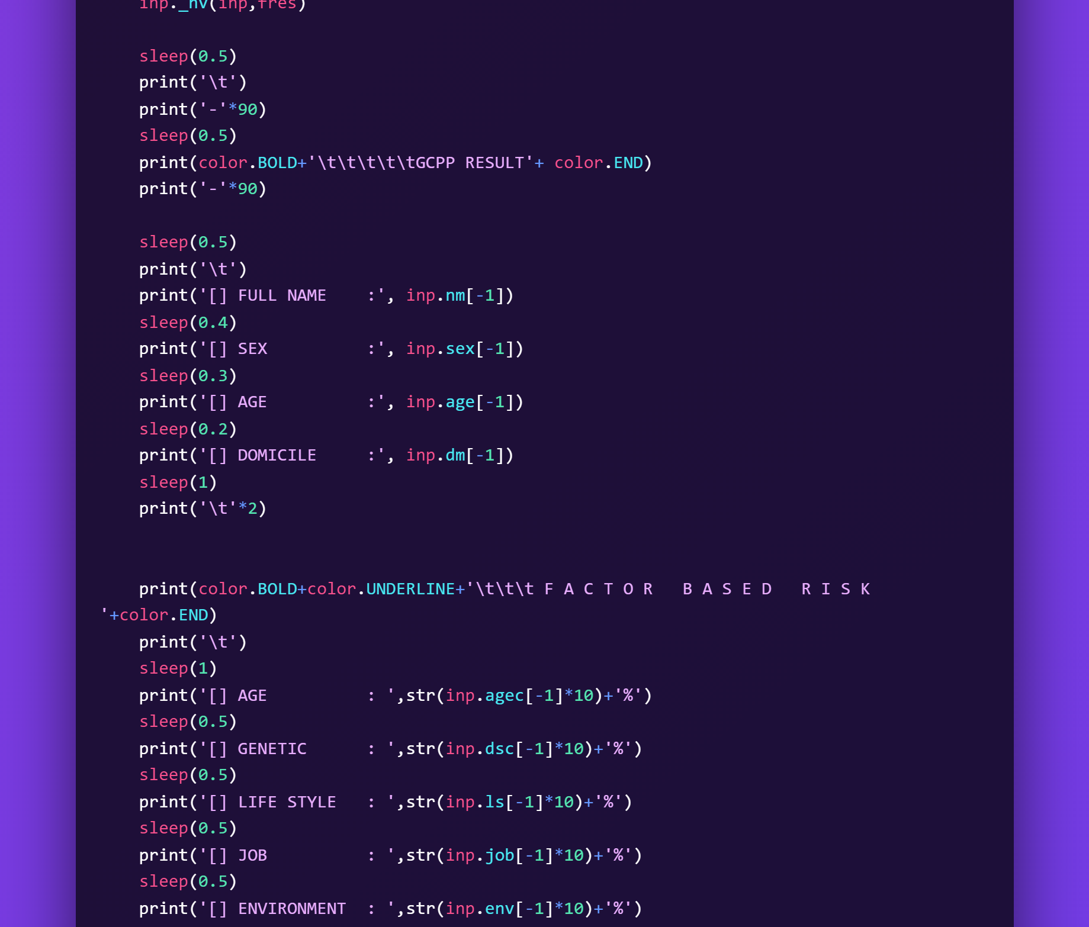
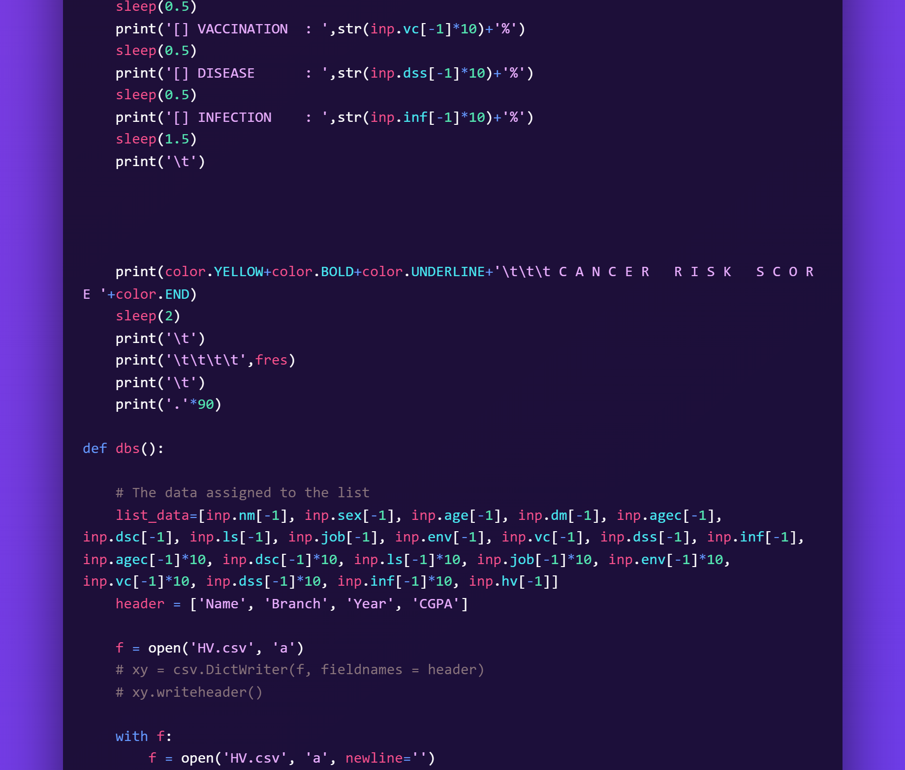
SIMPLE DECISION TO ADD VALUE
SHOWING THE RESULT OF CALCULATION
STORE DATA TO .CSV DATABASE

Slide 17
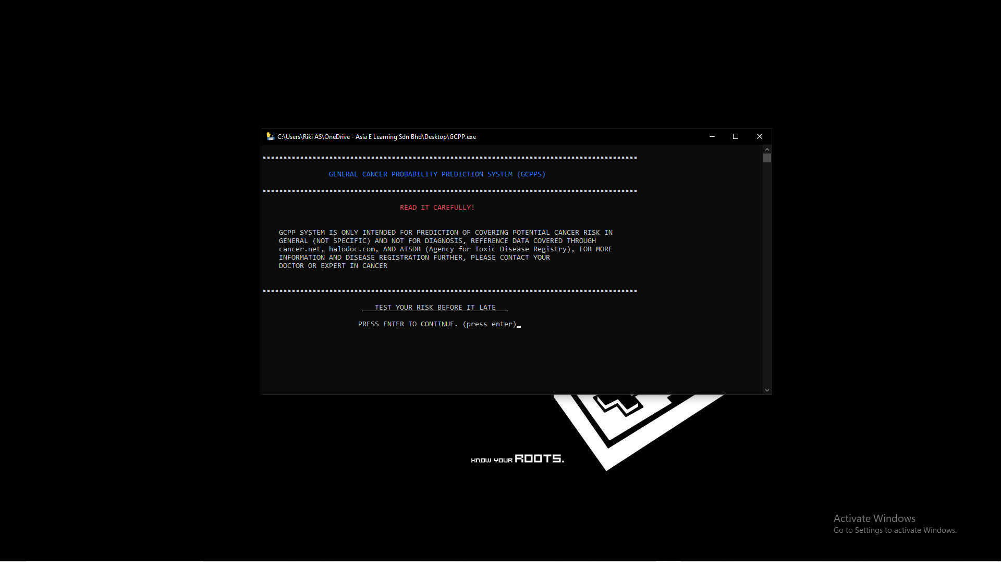
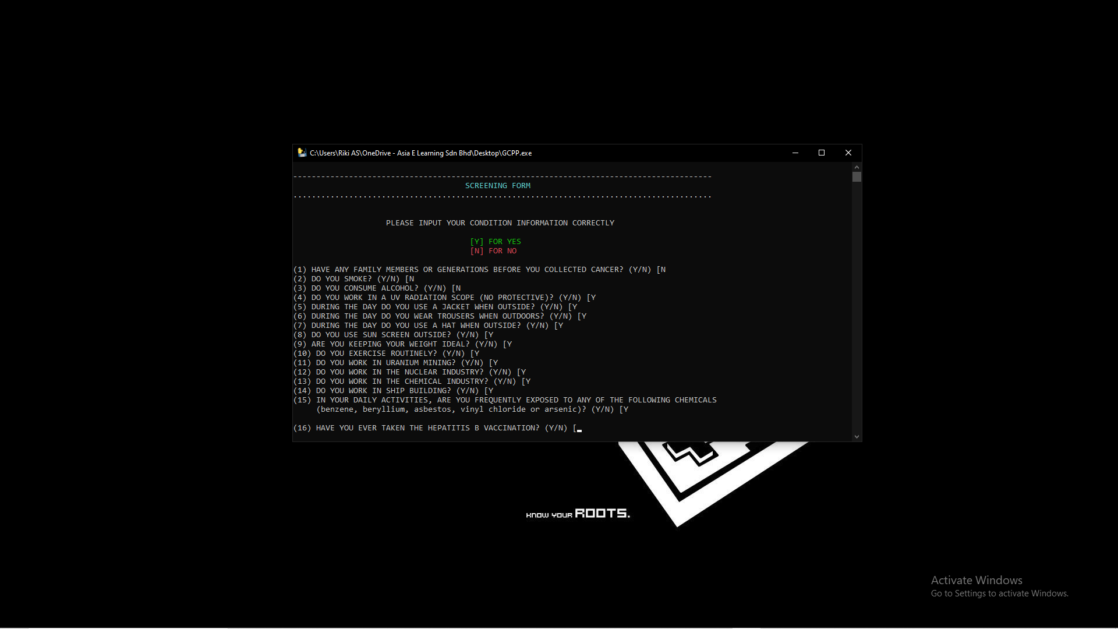
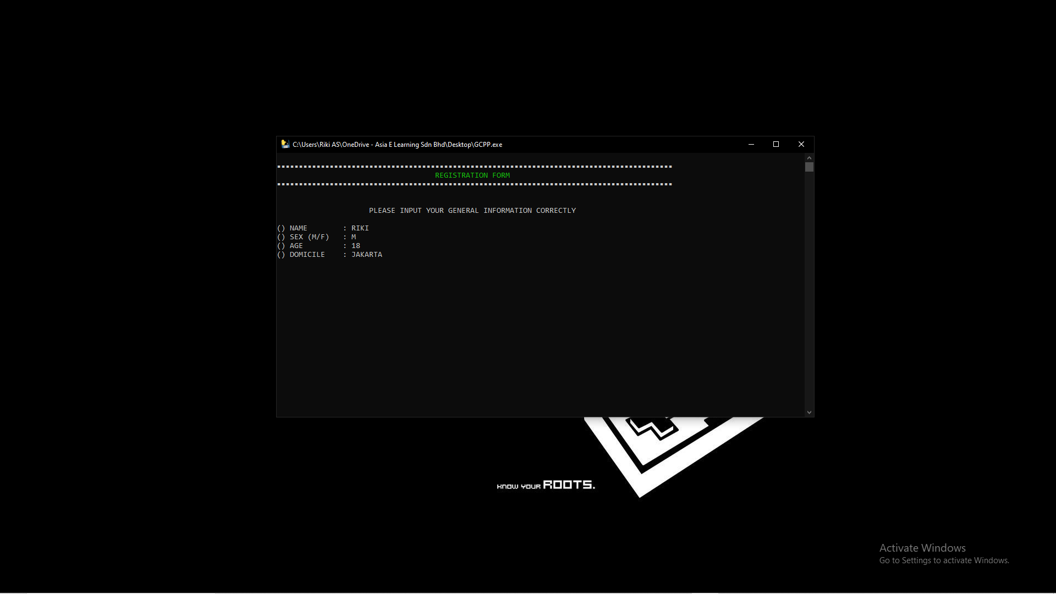
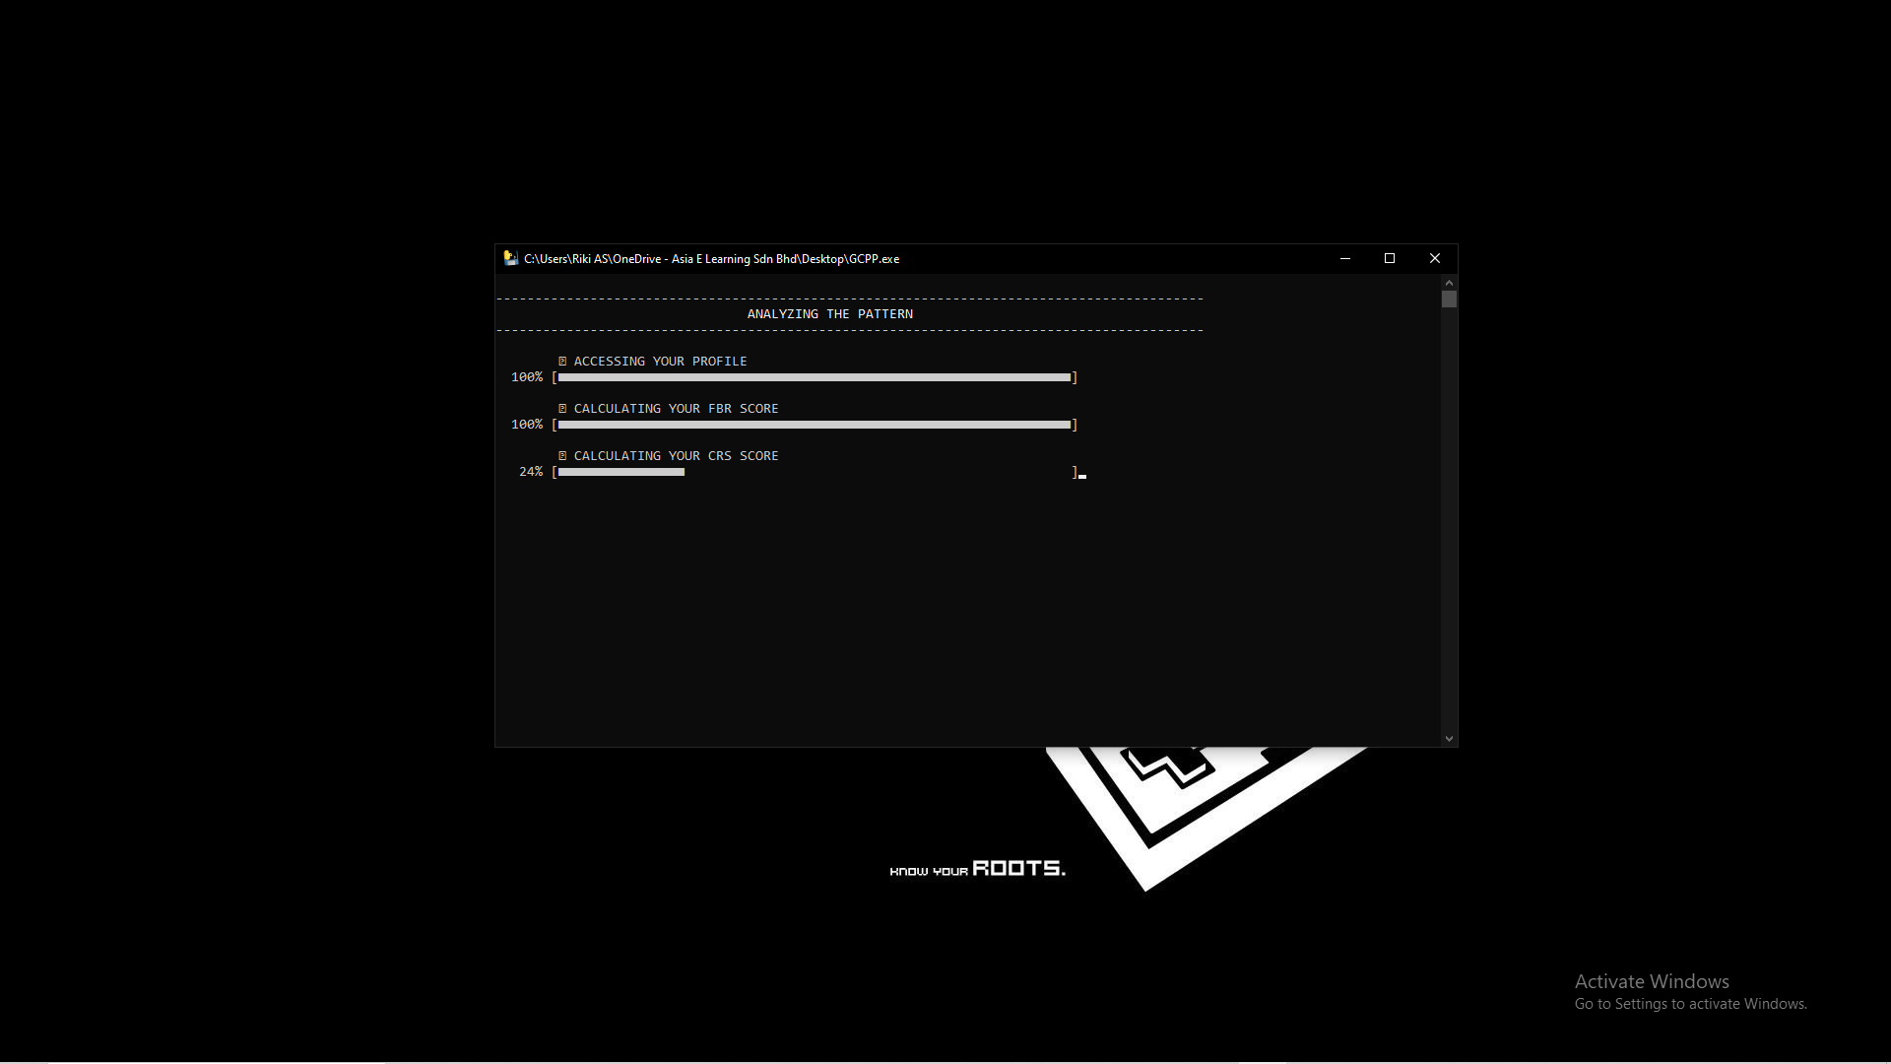
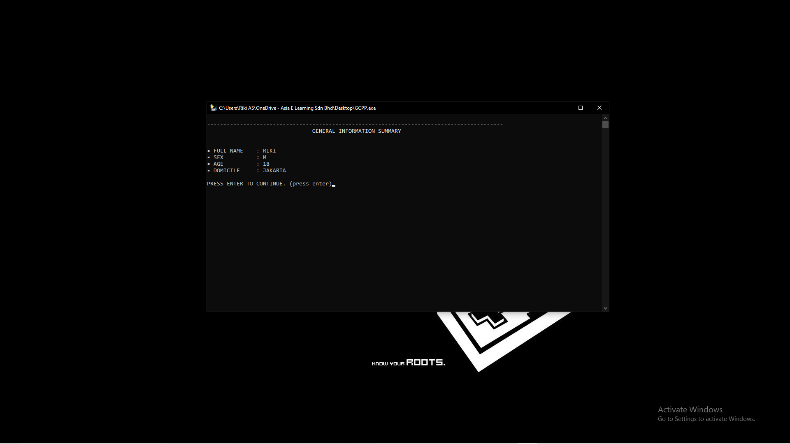
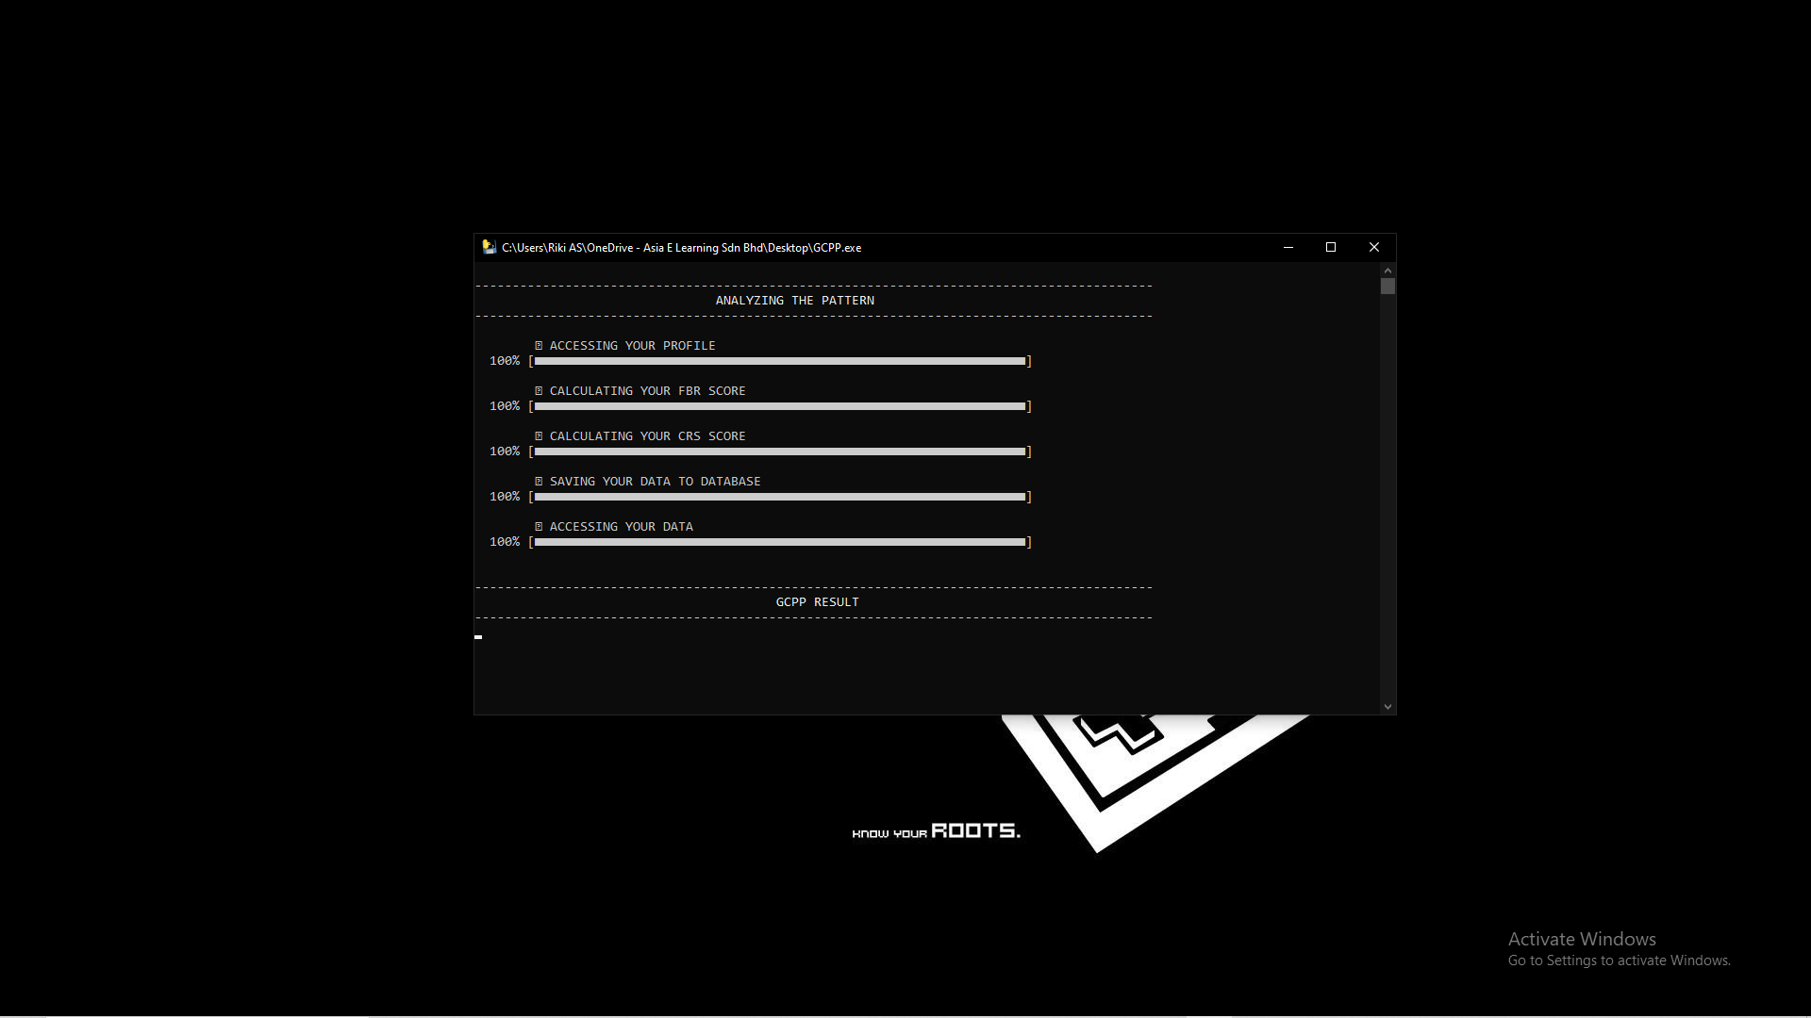
THE RESULT
[1]
[4]
[2]
[5]
[3]
[6]

Slide 18
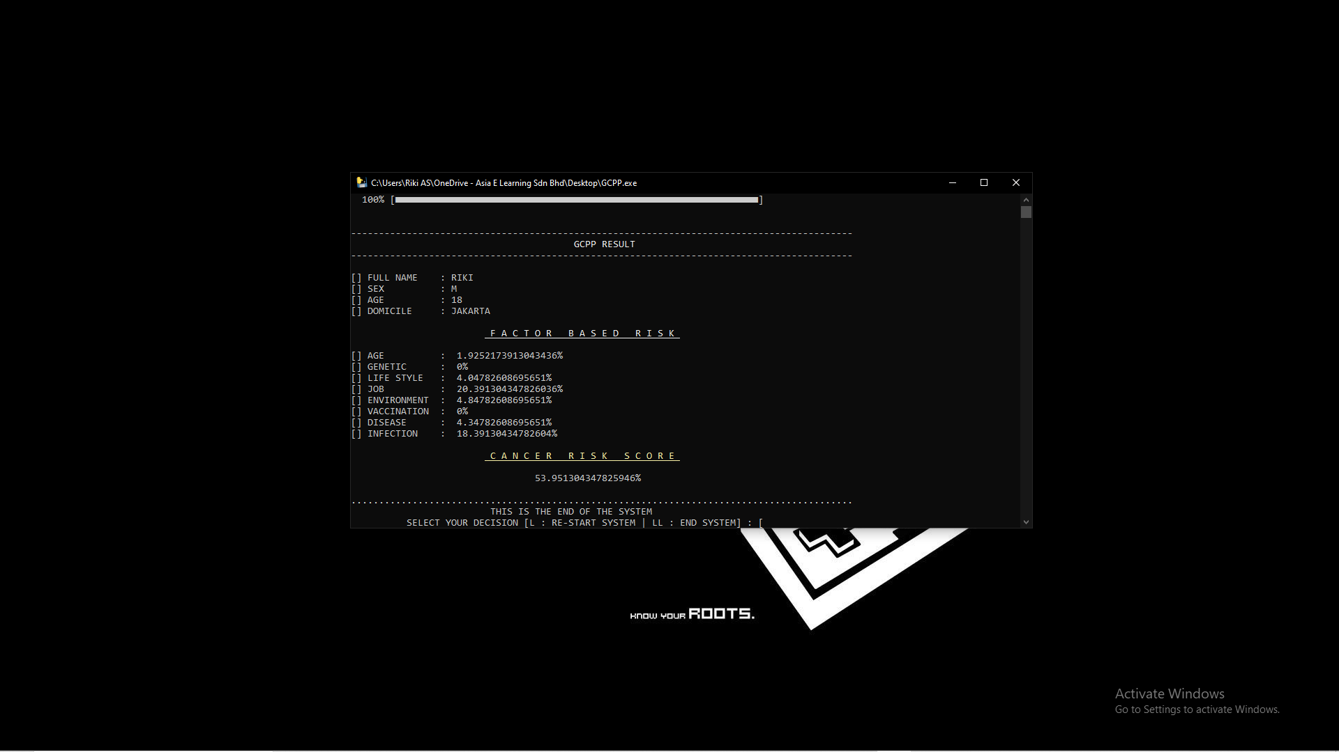
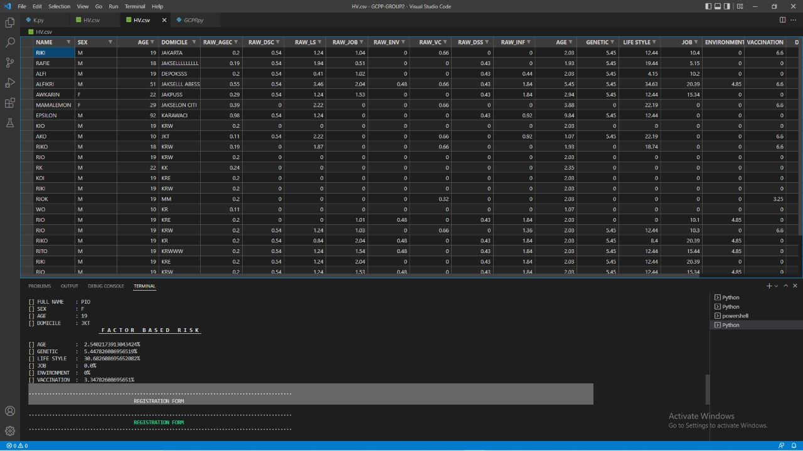
[7]
HV.CSV DATABASE
(Historical Value)

Slide 19
04
CONFIGURATION
I recommend this!

Slide 20
System Requirement Recomendation
Hardware : Intel I7 gen 11, RAM 16 GB HDD 100 GB or 1 TB, Video graphicNVidia GeForce RTX 3080
VGA Resolution : 7680x4320
Operating System : Windows 11
Software : - Command Prompt
- Microsoft Word 2021
- Microsoft Excel 2021

Slide 21


THANKS!

